Slide 1
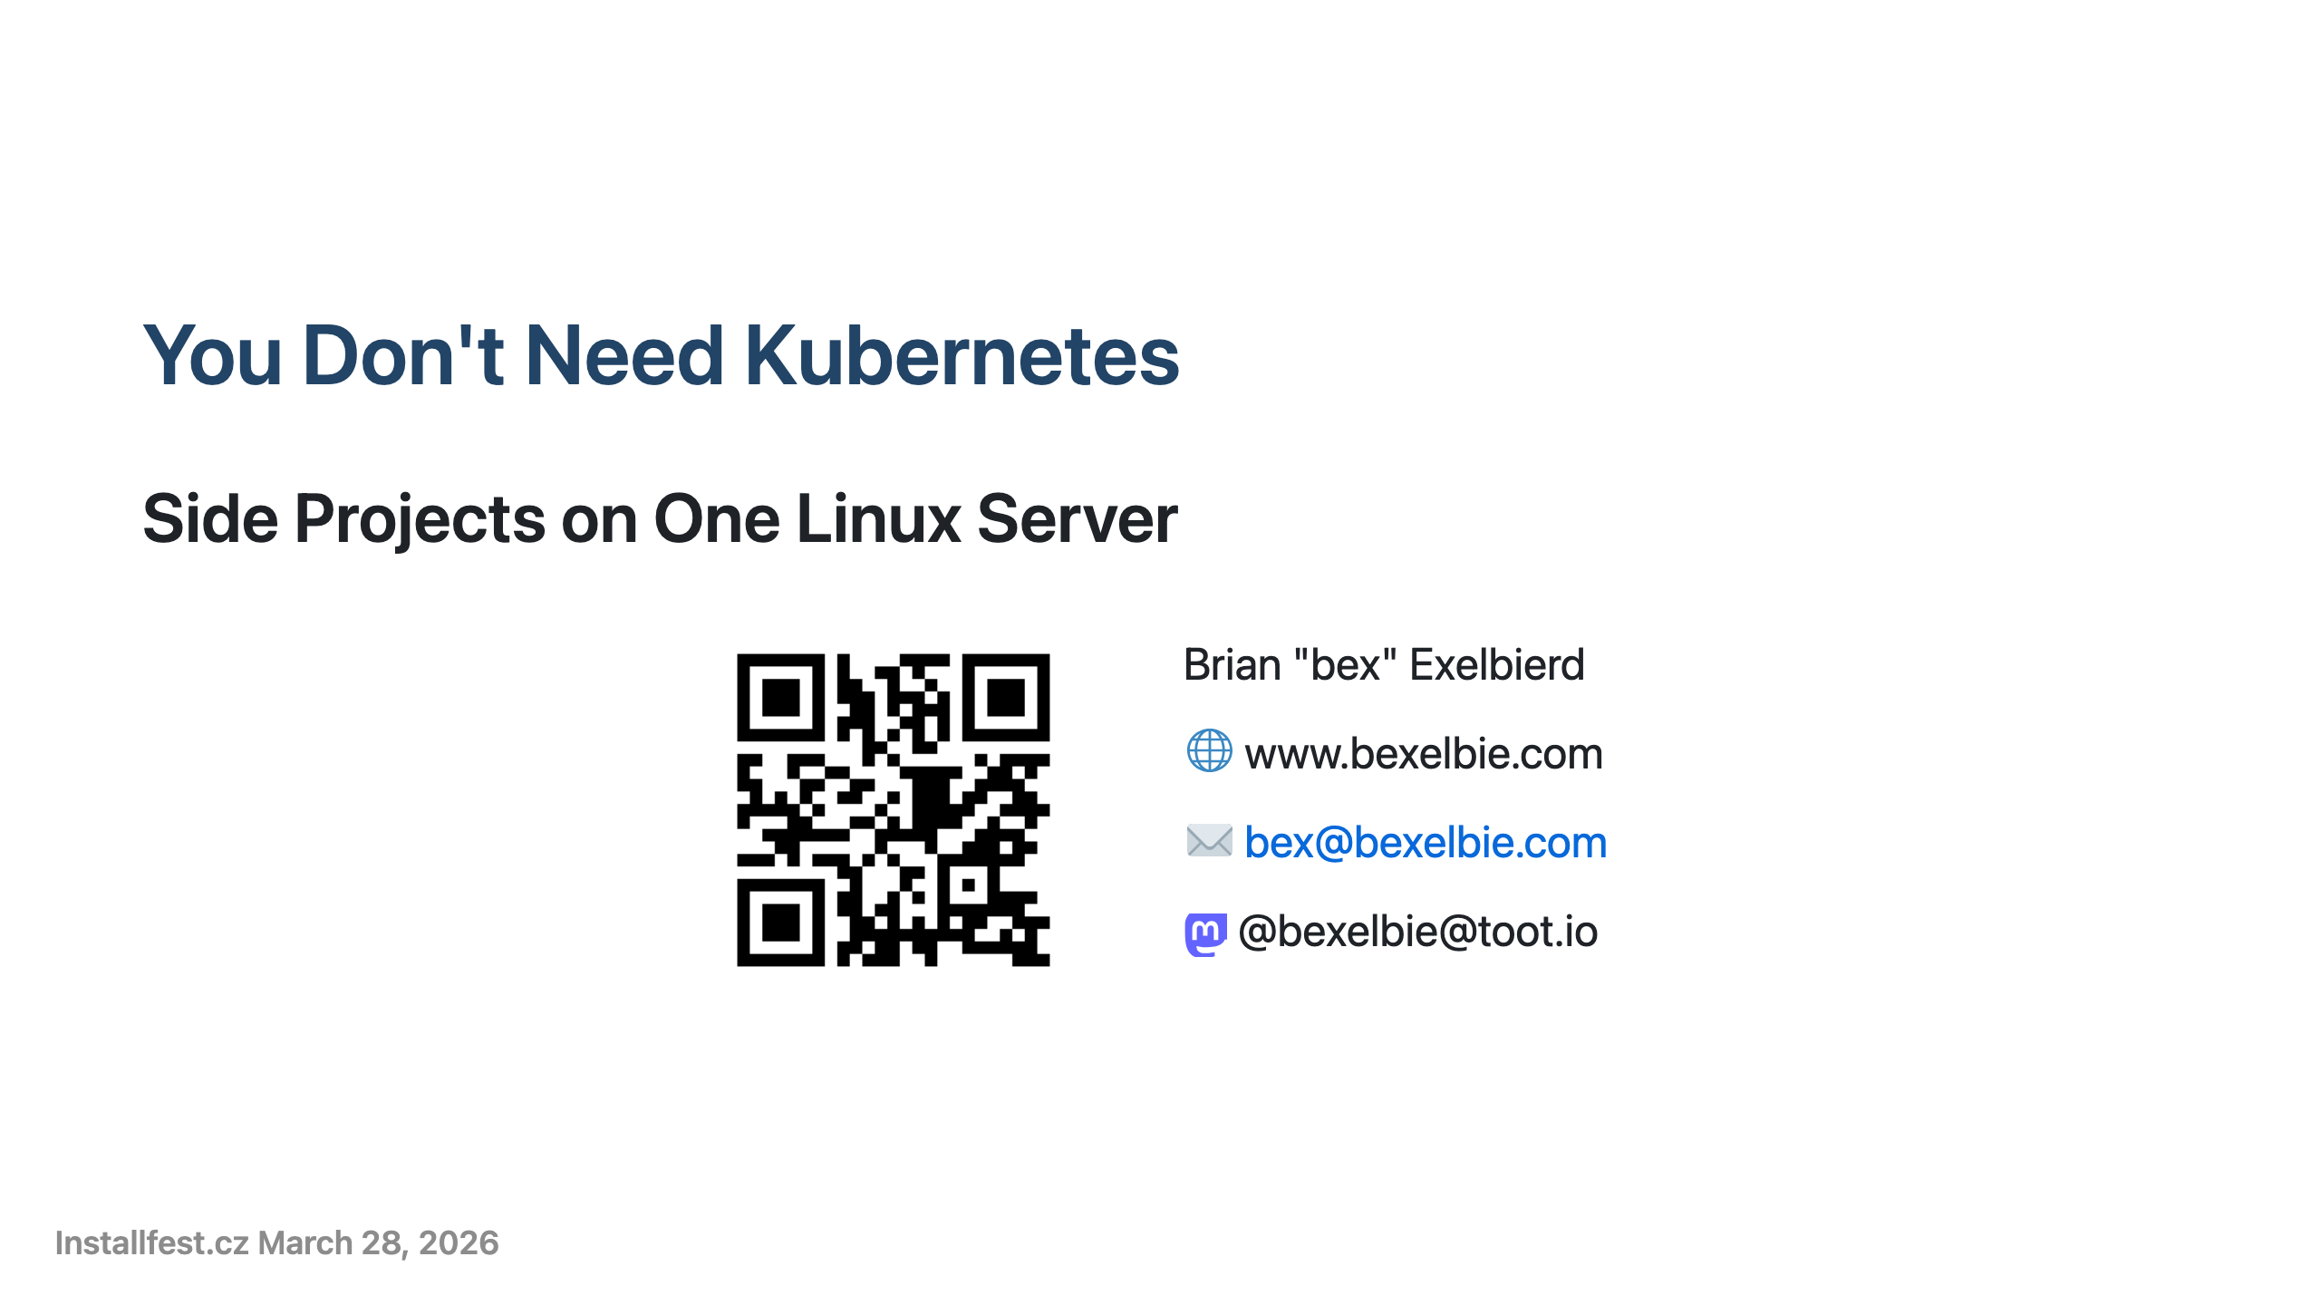
Notes:
- This talk is about how I run a real web service on the internet without Kubernetes, Grafana and the rest — and how it mostly takes care of itself - I'm Brian Exelbierd — worked with Linux for over 20 years - 10+ years at Red Hat, now working on upstream and community Linux for Microsoft Azure - I live in Brno and have been in the CZ for 13 years - I don't speak great Czech, which is why this talk is in English - Slides are online at the QR Code and on my website - Disclaimer: My employer, Microsoft has funded my travel to installfest.cz, but this project doesn't reflect their view of the world. I use Azure in this side project and projects, like Flatcar that they support, but this isn't the only answer. Use what ever you want.

Slide 2
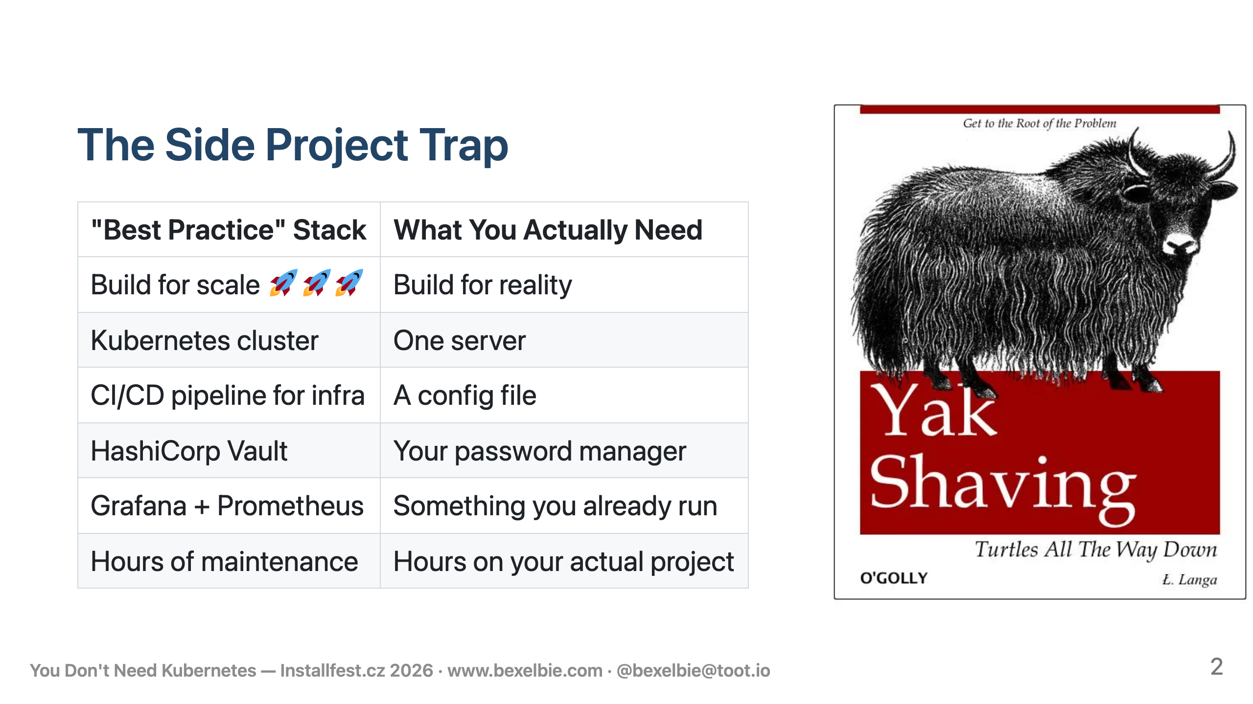
Notes:
- We've all been here. You have an idea. You want to put it on the internet. - You go read blog posts about how to do that. - Suddenly you're building for scale far in excess what you'll ever have - You're standing up Kubernetes, a secrets vault, a monitoring stack and more just to keep your infrastructure running - This is fun if you want to learn those tools. - But if you actually want to build and run a side project, it's a trap. - The infrastructure becomes the project. The actual thing you wanted to build sits neglected. - This talk is about a different approach: what if you stopped asking "what's the best tool for this?" and started asking "what do I already have that solves this?"

Slide 3
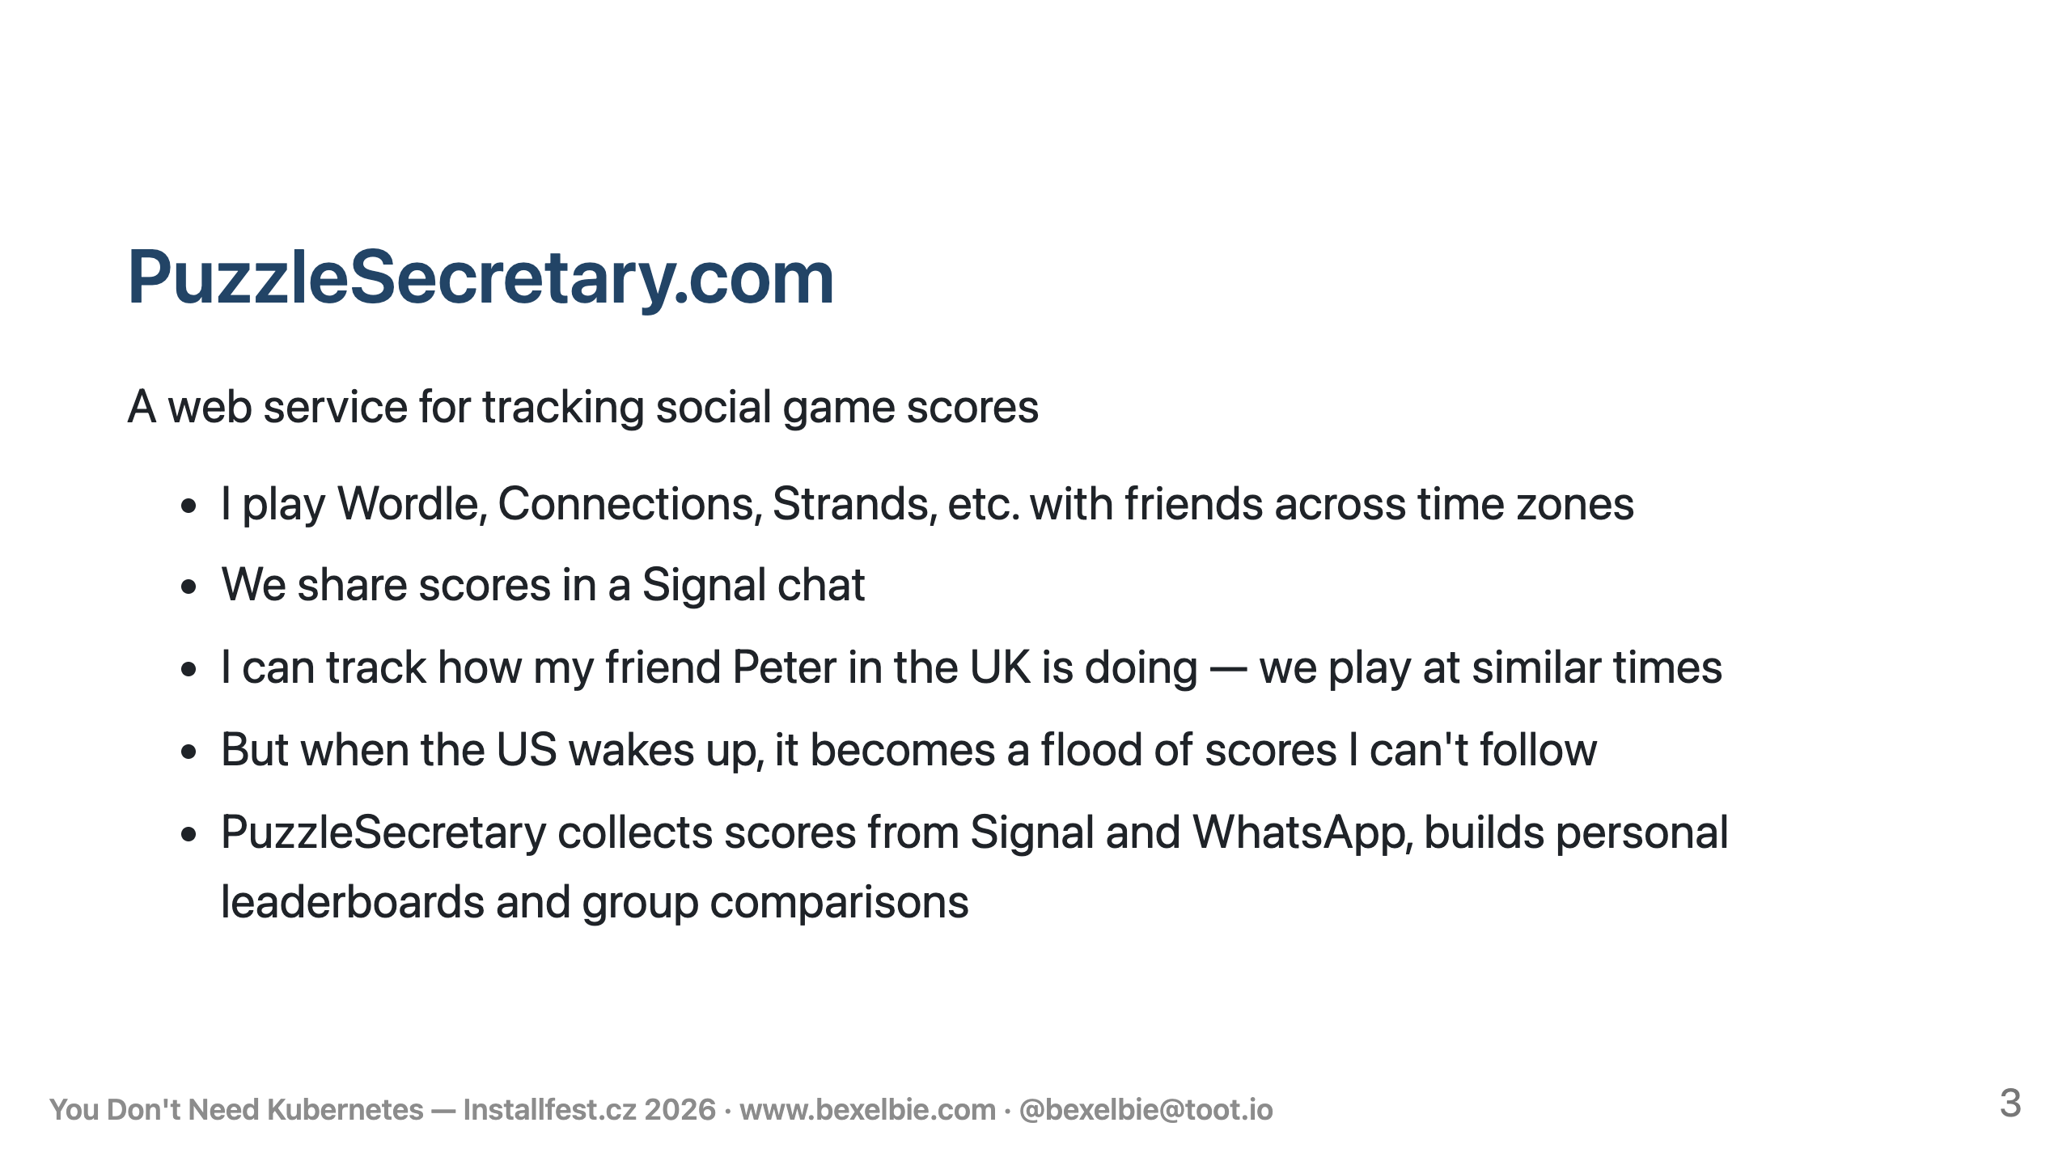
Notes:
- This is the thing I actually wanted to build. PuzzleSecretary. - I play a bunch of social word and logic games with friends. We're in a Signal group chat. - My friend Peter is in the UK. We both play in the morning. I have a great feel for how he's doing. - I tend to do better at Wordle than Peter — are we recorded? - But around the afternoon, all the folks in the US wake up and post their scores - It becomes a stream of content I can't keep up with. - I genuinely care how people are doing. - On a day with a particularly hard I'll go searching through the chat - But mostly I want it all rolled up — leaderboards, comparisons, trends. - That's the idea - It needs to talk to Signal and WhatsApp - It needs to always be on. It needs to be reliable. - And critically: I want to spend my time adding games and features, not being a system administrator.

Slide 4
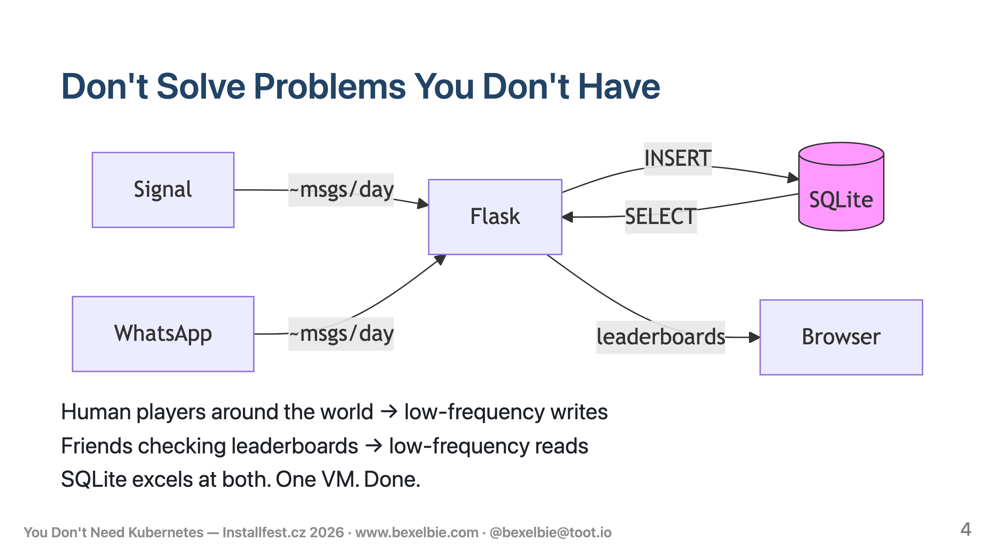
Notes:
- Before we get into architecture, the most important decision you can make is to - Not solve a scale problem you don't have - PuzzleSecretary gets messages when people play games - It serves pages when they look at boards - Back of the envelope math on basic reads and writes says I should be able to scale to potentially 100,000+ active users on a single server - Probably even the server I am using - the 2nd smallest (or smallest) VM Azure offers - I should be so lucky that I overflow my ability to scale this.

Slide 5
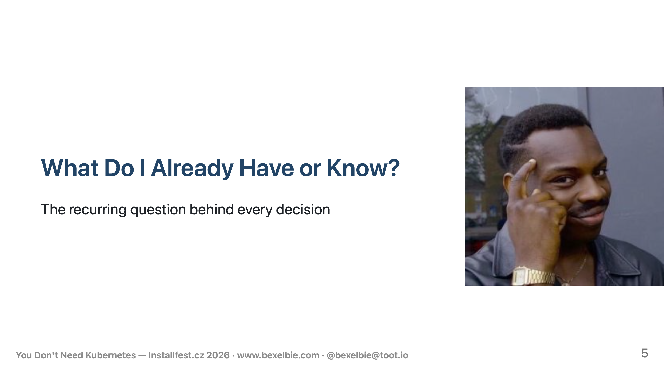
Notes:
- This is the thesis of the talk - Every architecture choice I'm about to show you came from asking - "What do I already have — or already know — that solves this problem?" - Not "what's the best tool?" Not "what would a blog post recommend?" - But "what's already running, already paid for, or already understood?" - Let me show you how this plays out for the operating system, application deployment, secrets, networking, and monitoring

Slide 6
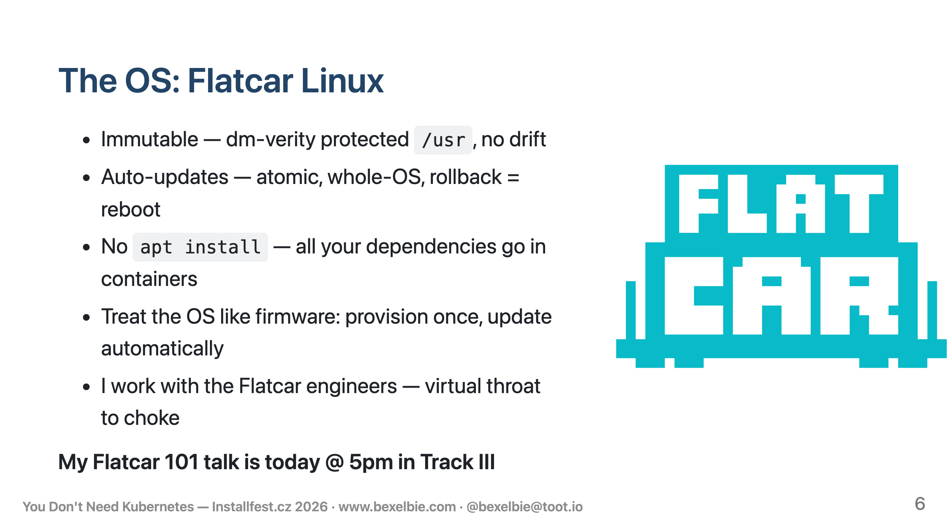
Notes:
- Flatcar is an immutable, container-optimized Linux - The base OS is read-only and dm-verity protected - You can't break it accidentally - or on purpose without serious effort. - Updates are atomic: a new OS image gets staged to an inactive partition, verified, activated on reboot - If it fails, reboot to the old partition. No intermediate states - I schedule Wednesday morning updates and expect to never notice. - You can't apt install things on Flatcar. That sounds like a limitation, but it's the point - It forces all your dependencies into containers - which moves dependency management from the OS into the application build where it belongs - I'm giving a whole separate Flatcar talk at this conference, so I won't go deeper here - But the key idea for this talk: the OS takes care of itself - That frees me to focus on how my application runs - which is the next slide.

Slide 7
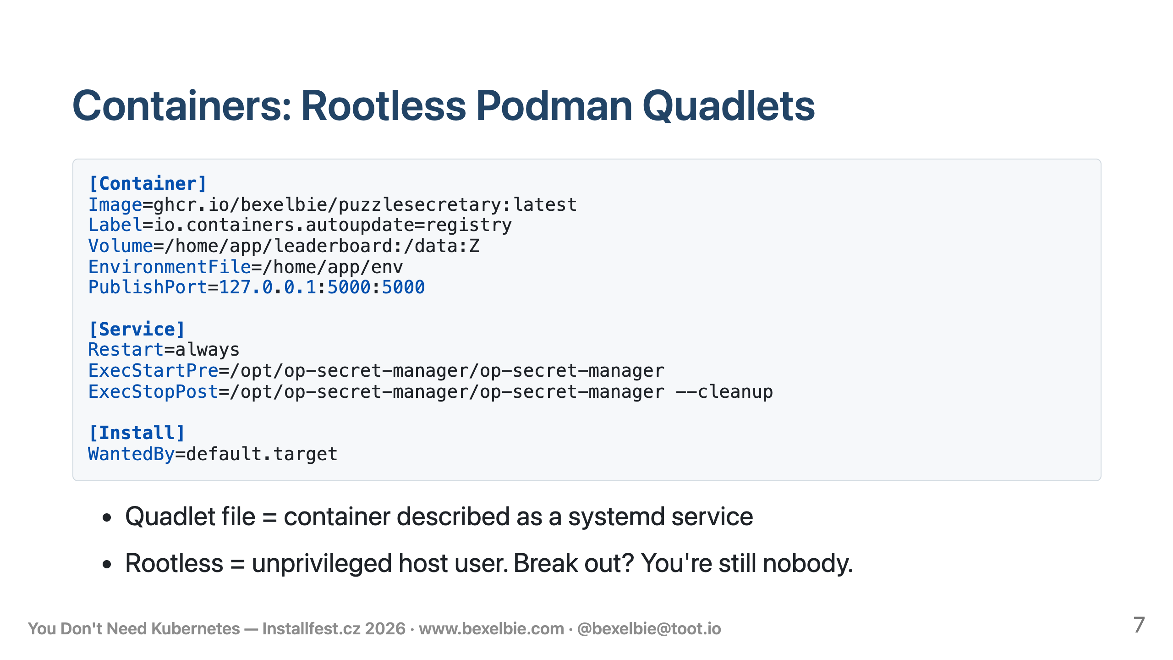
Notes:
- Podman is a container runtime - most of you probably use Docker - Podman is basically the same - same OCI container images, same registries - Two differences matter here: Podman has no central daemon - and it was built for rootless early on - It also has quadlets - if you know systemd, you already know how to manage Podman containers - Rootless is a key security feature. The container runs as a non-privileged user on the host. Even if someone breaks the app, becomes root in the container, AND escapes to the host - they're just a regular user. They need another exploit to get anywhere. - Containers are great, but to use them you have to run them - Docker makes you write systemd units, rely on their daemon or learn compose - I use Podman Quadlets for this. A Quadlet is a Podman-specific file that describes a container - You drop it in a directory, run systemctl daemon-reload, and systemd picks it up as a service - Automatic restarts on failure, logging to journald, dependency ordering between services - all for free - No container orchestrator needed. - Let me walk through this. - Image - where to pull the container - if it isn't already on disk - Label - that tells Podman where to check for newer images - more on this later - Volume - persistent SQLite data that survives container restarts - EnvironmentFile - secrets get injected here, we'll come back to this too - PublishPort - Flask on 5000, bound to localhost, I'll explain why in a bit - In services you see the standard systemd restart - and ExecStart and ExecStop deal with secrets management - which is the next slide

Slide 8
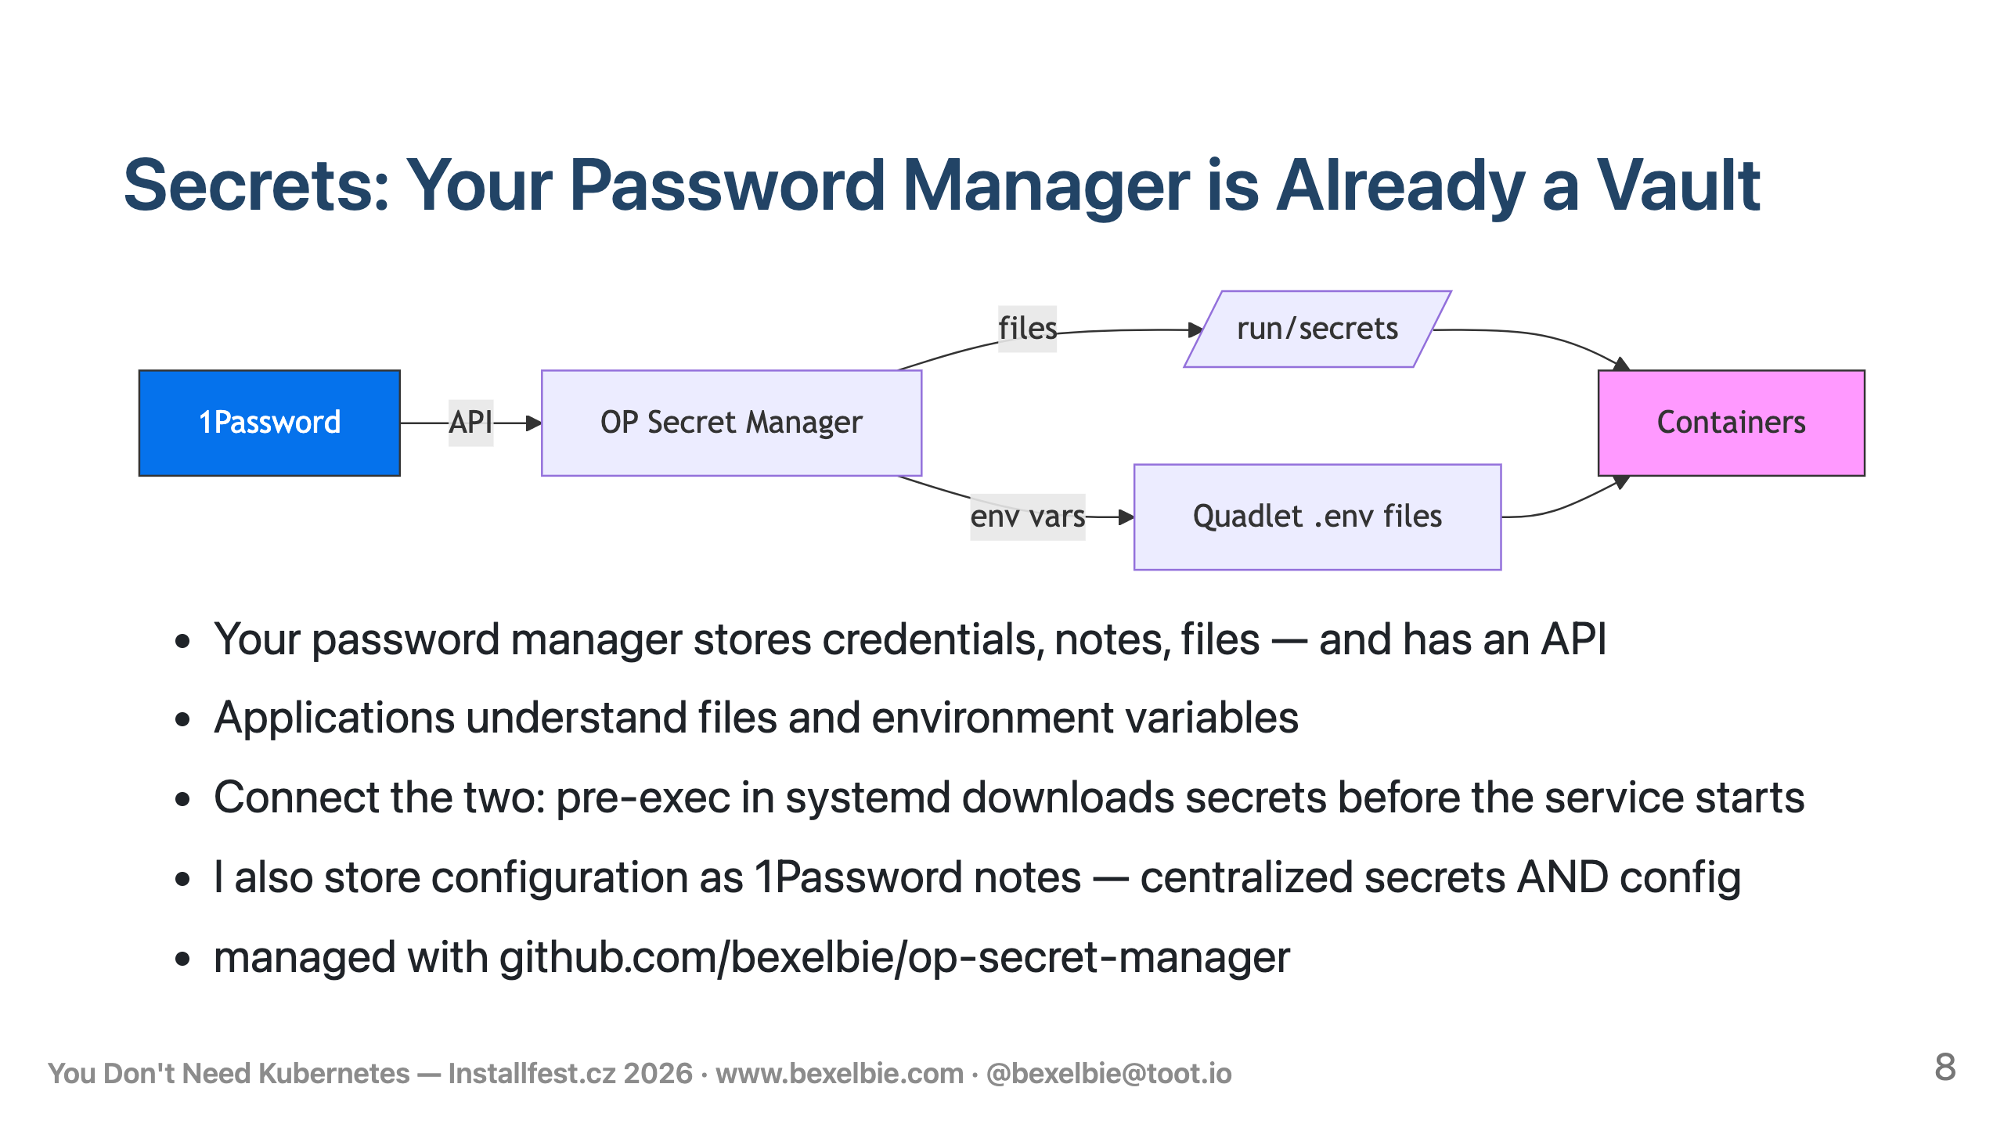
Notes:
- Secrets management is hard - Having secrets spread out in multiple places is harder - I have both manage them and remember where they are - But I already have a secrets management system - 1Password. Family plan, works across all my devices - and it has an API. - Applications understand files and environment variables, not 1Password - I built op-secret-manager - Before a service starts, systemd runs it as a pre-exec step - It downloads secrets from 1Password and puts them where the service expects — files in /run, environment variable files that Quadlets inject - Post-exec cleans up. - This extends beyond secrets - I store JSON and YAML configs as 1Password notes too. Centralized secrets AND configuration in one place I already managed.

Slide 9
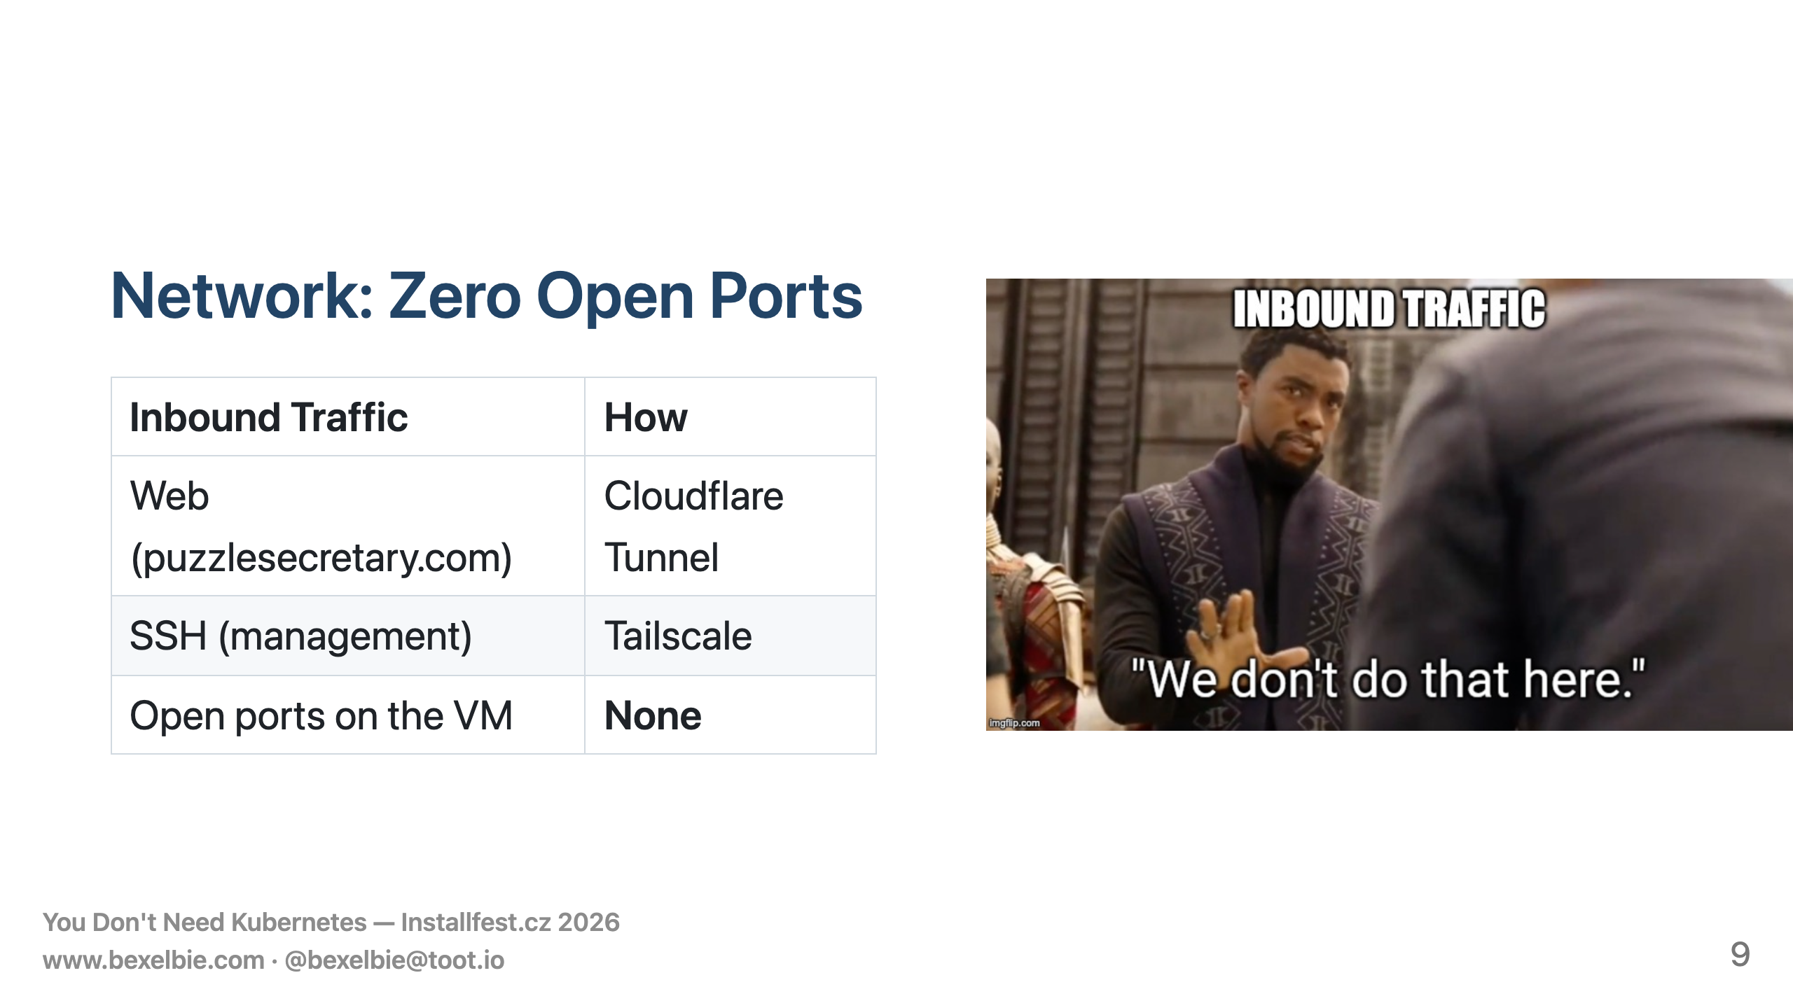
Notes:
- Two networking choices, both driven by reducing attack surface. - Cloudflare Tunnel: a container on the host connects outbound to Cloudflare - When you visit puzzlesecretary.com, Cloudflare routes the request down the tunnel - No port 443 open - Bonus: no SSL certificate management. Free tier. - Tailscale for a private network/VPN - installs on Flatcar as a systemd system extension - no container wrapper needed. Connects to my tailnet - SSH from any of my devices, port 22 not open to the world - Both connect outbound. No inbound ports needed on the VM at all

Slide 10
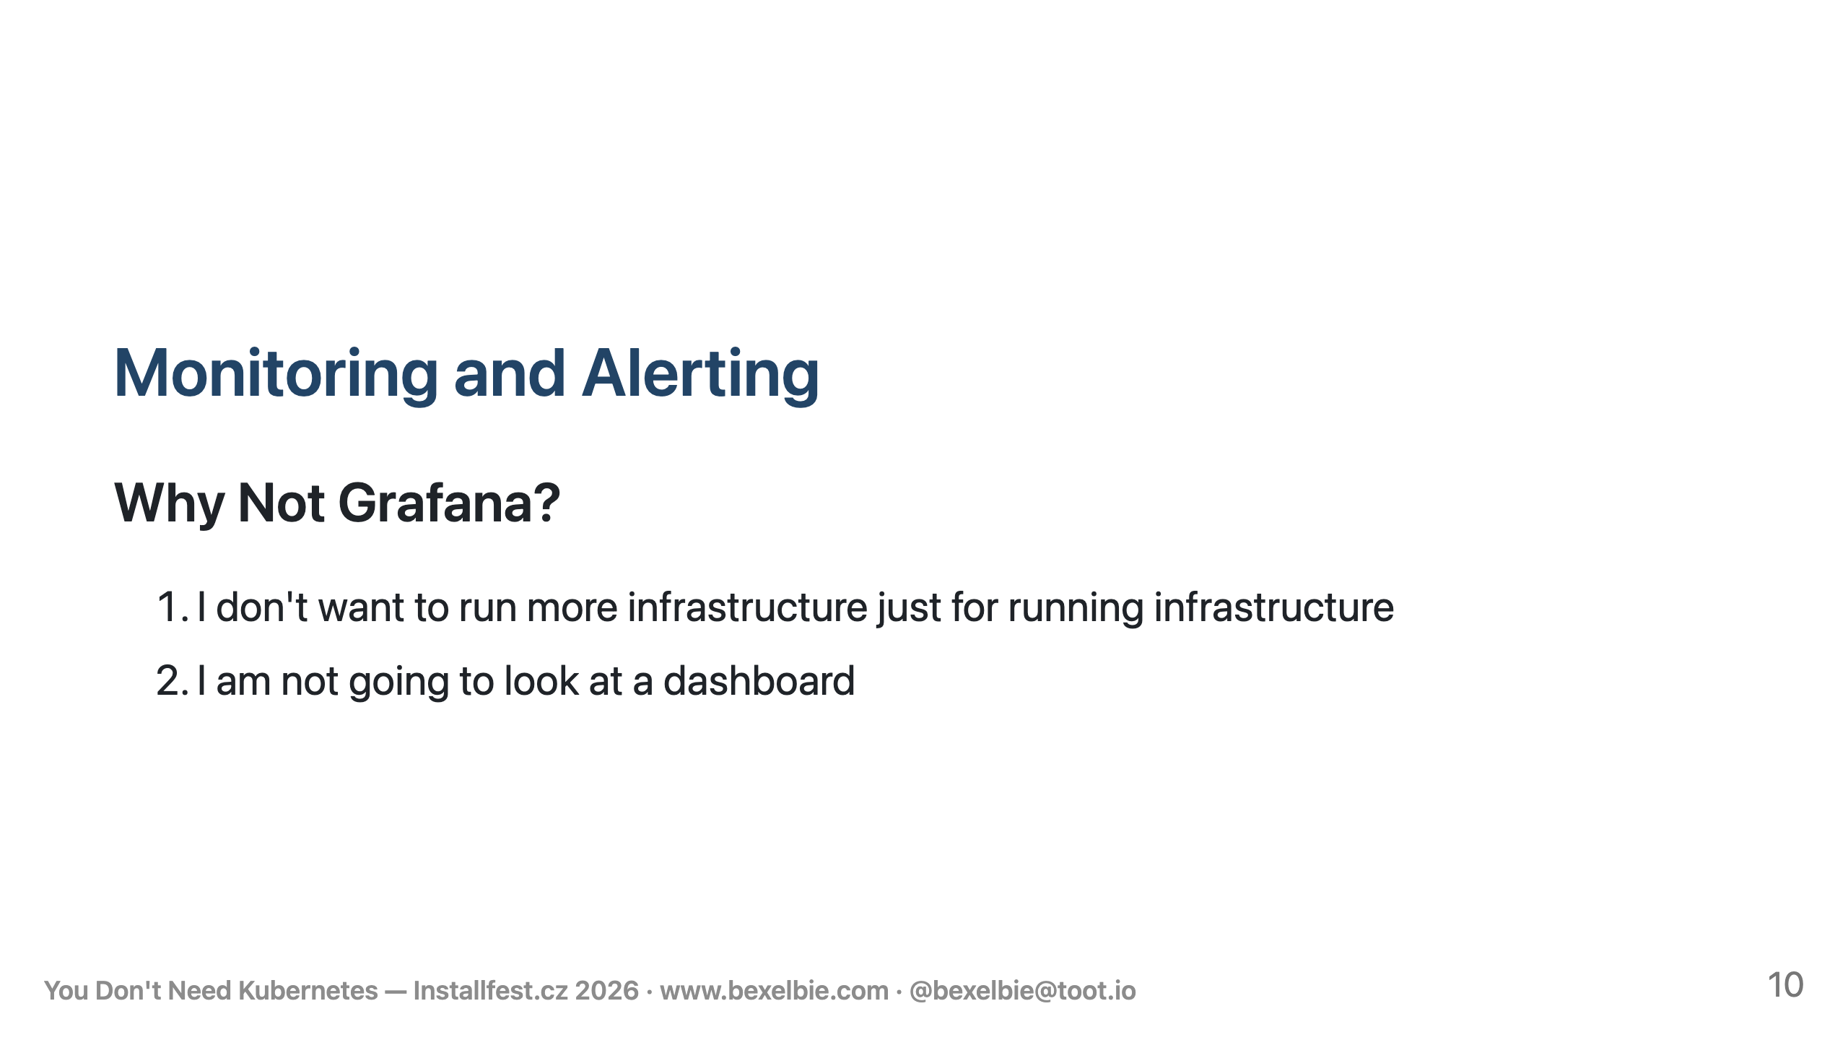
Notes:
- This is where the "what do I already have?" question gets its most interesting answer. - Most people would solve monitoring by standing up Grafana or something similar - or a SAAS version ... and then doing a bunch of instrumentation work - I had two reasons for going a different way. - First: I don't want to stand up another piece of infrastructure. - The whole point of this talk is avoiding that. - Second, and more importantly: I am not going to look at a dashboard. - I'm not going to get up every morning and check traffic graphs - I'm not going to keep a monitor in the corner with pretty lines and blinky things - This isn't my day job. - I want this thing to run itself off to the side like a good side project should - and let me do the cool thing — adding more games, improving the UX, whatever - But I can't just ignore the problem entirely - One day this thing will fall over — out of memory, disk full, something - When that happens, I'll want to understand what the utilization curve looked like - I need to track key pieces of information that help me debug - and that might not be in logs - The first question to answer is, "how do I get this data?"

Slide 11
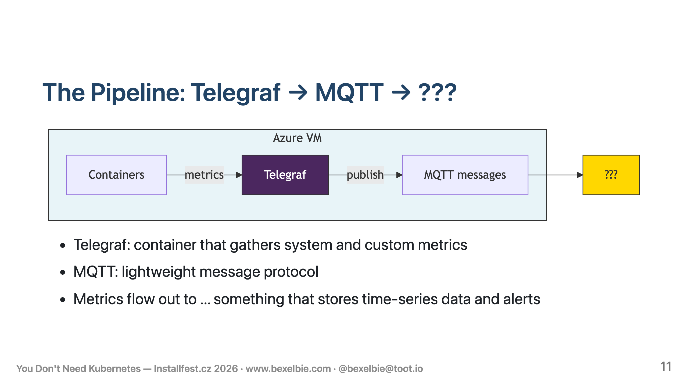
Notes:
- On the collection side I use Telegraf, from InfluxDB - It is an open-source metrics agent - It's a container that runs on the VM, gathers CPU, memory, disk, process counts - It also reads custom metrics — I use this to track how many containers need updates - It publishes MQTT messages to ... well that is question 2 ... - I need something that tracks values over time, stores them, graphs them - ... and isn't Grafana because I ruled that out.

Slide 12
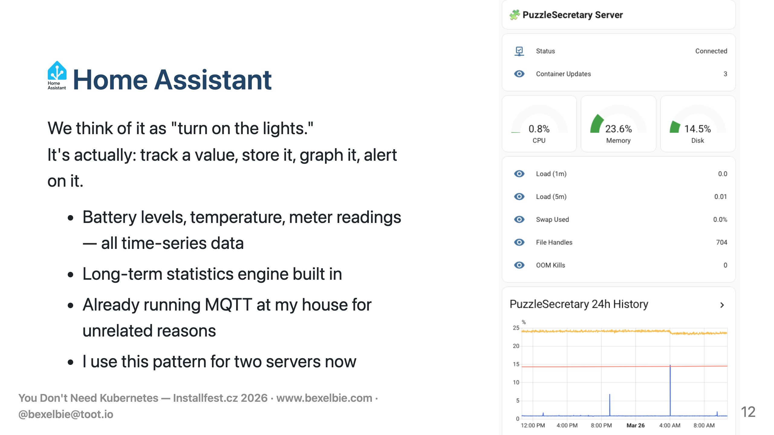
Notes:
- Home Assistant - Most people think home automation — turn on the lights. - But a big part of HA is being a time-series database - take a value, store it, graph it over time - Battery levels, temperature, water meters - all tracked with a long-term statistics engine - I already run it on a Home Assistant Green at home - And it was already running MQTT because I have a light that speaks MQTT - And it is on my Tailscale Tailnet because I want to get to it from anywhere ... - So I pointed Telegraf's MQTT output at HA - It picks up the metrics, creates entities, stores them in long-term statistics - Here's what the dashboard looks like - It works so well I wired up my other VPS that I use for personal workloads — I rarely look at it, but it's there if I need it

Slide 13
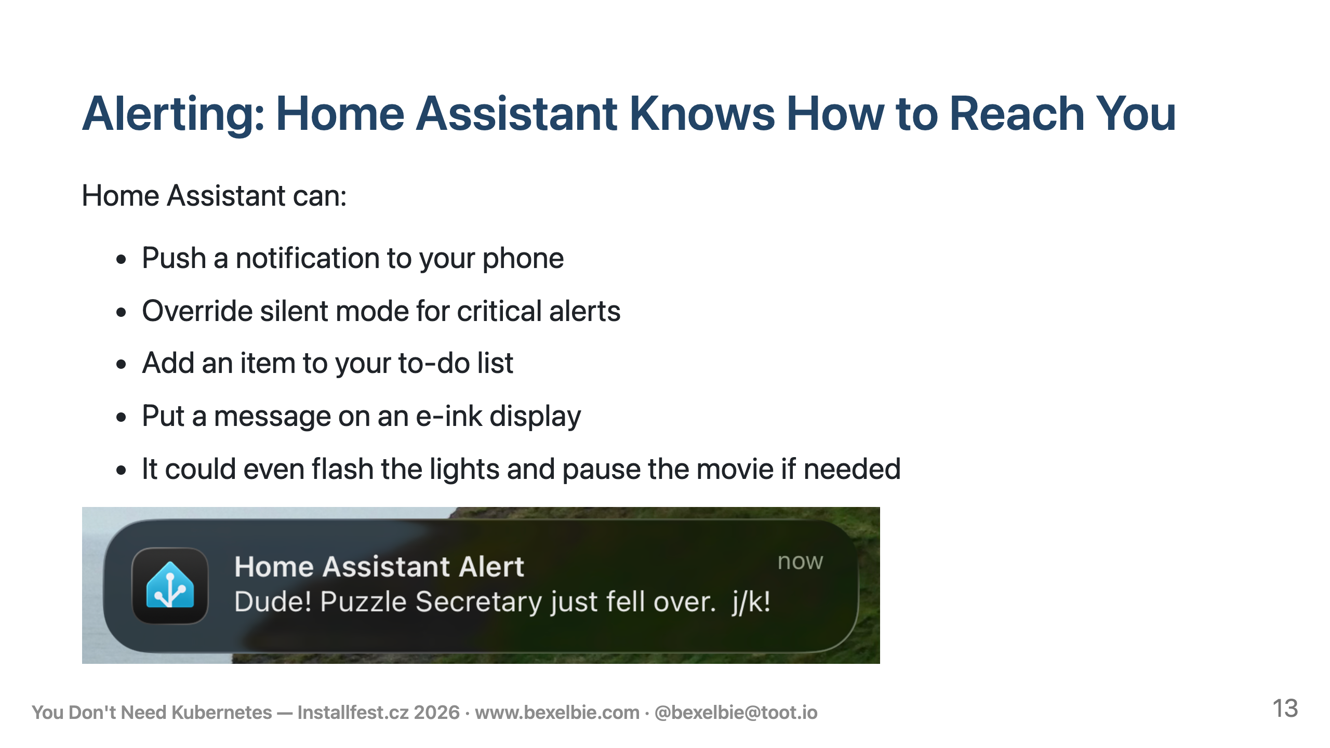
Notes:
- Gathering statistics is one thing. Alerting is something else - But if you think about it, HA solves this too - HA already knows how to send me notifications - It literally knows where I live - It can push to my phone - It can override silent mode for critical alerts - It can add something to my Todoist task list - It can put a message on an e-ink display - All I had to do was write a few automation configs to look at the incoming data and decide when I need to know about something - Container updates? Entry in my to-do list: "On Wednesday, update these containers." - Memory concerns or high CPU? Alert to my phone. - The system stops sending metrics at all? That means it fell over — tell me immediately. - I didn't have to build an alerting system - I didn't have to sign up for PagerDuty - I wrote a few automations using a system I already understood - and that I already need to have running

Slide 14
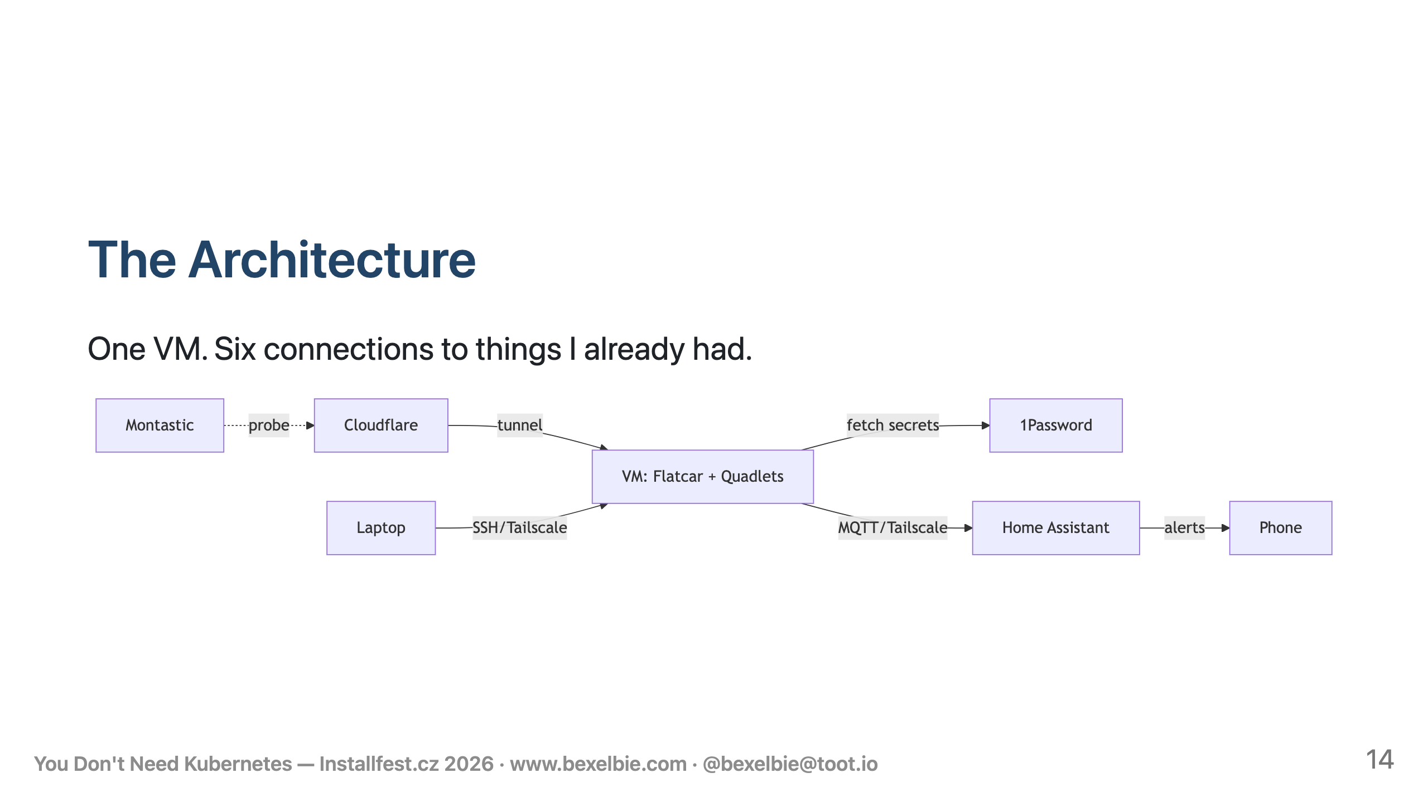
Notes:
- So here's the complete picture - everything we just walked through on one diagram. - One VM running Flatcar Linux - Inside it, rootless Podman containers managed by systemd Quadlets. - Secrets and configuration come from 1Password over its API. - Public traffic comes through a Cloudflare Tunnel — no open ports. - I SSH in over Tailscale — also no open ports. - System statistics flow over MQTT through Tailscale to Home Assistant at my house. - Home Assistant handles monitoring, alerting, and notifications. - Every external connection here is something I was already running for other reasons. I stood up zero new infrastructure services other than the literal VM I am using for the service - I also use my existing Montastic.io free account to provide an external "is it still alive?" check

Slide 15
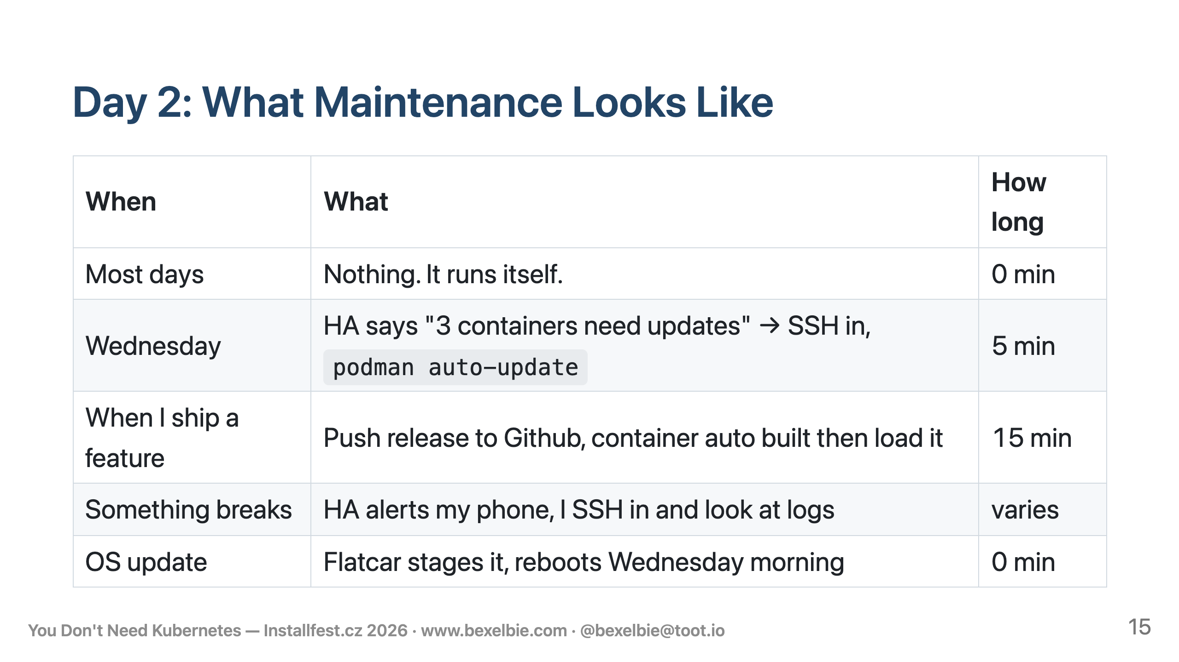
Notes:
- So what does this actually feel like to run? - This is the part the architecture diagrams don't tell you. - Most days: nothing. I don't log in. I don't check dashboards. The system runs itself. - Wednesdays are my maintenance window - Flatcar handles its own OS updates the same morning. It stages the update to the inactive partition and reboots. I don't even notice unless something goes wrong - and if it does, it rolls back automatically. - Also for Wednesdays, Home Assistant adds a to-do item if containers have newer images - I SSH in, run podman auto-update, it pulls the new images and restarts the affected services - Five minutes, usually while drinking coffee. - This is going so well I'll probably just have it auto-update Just before the OS updates and drink my coffee while playing games instead - When I want to ship a new feature for PuzzleSecretary, I push a release in the repo and a Github action builds me a new container. The next auto-update picks it up and schedules it for Wednesday, or I trigger it manually if I'm impatient. - The whole promise of this architecture is - spend your time on the fun part - And this is what that actually looks like in practice - Most weeks I spend zero minutes on infrastructure

Slide 16
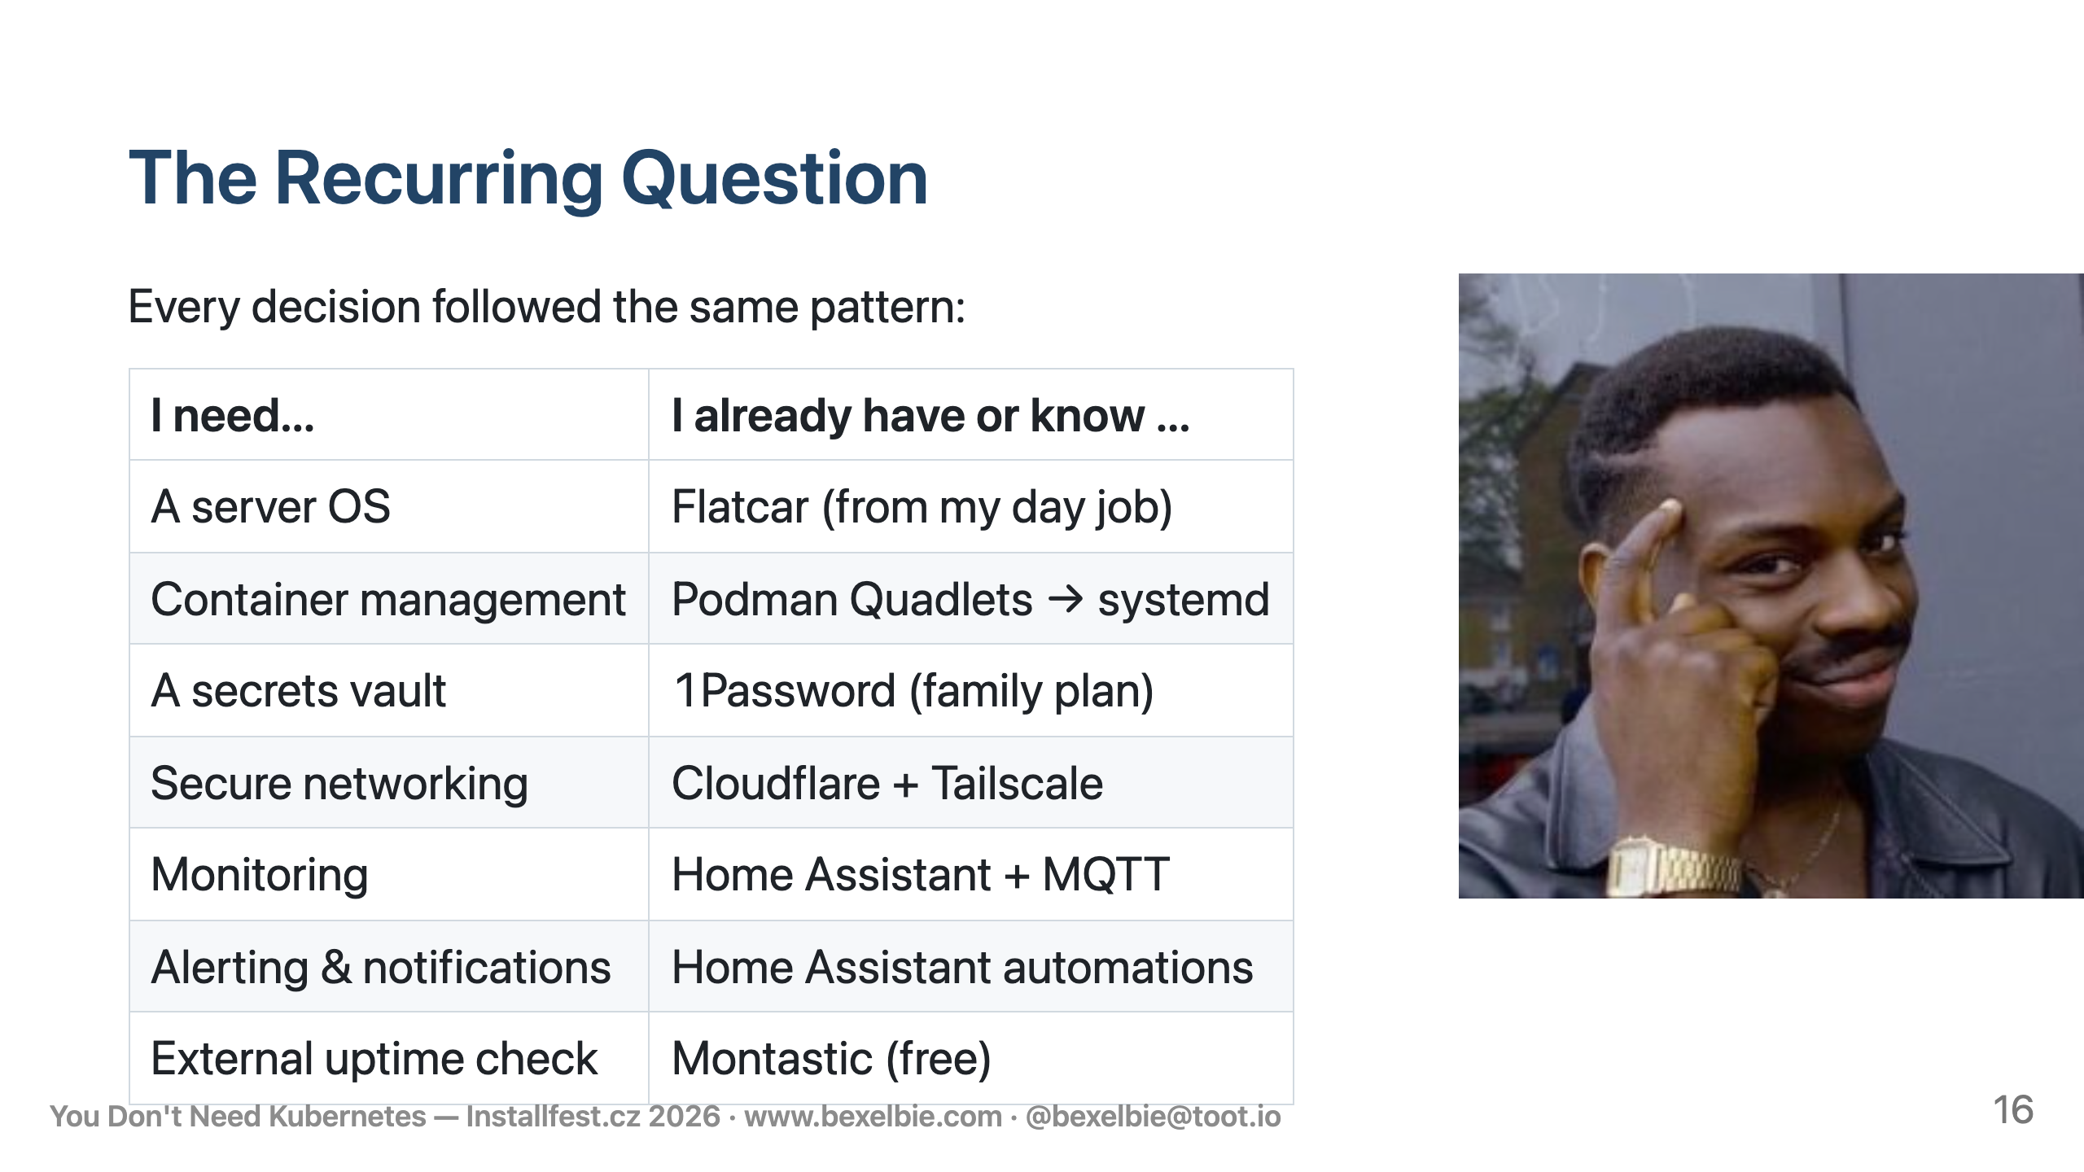
Notes:
- Look at this table - Every single row is the same pattern - I had a need. I looked at what I already owned, already paid for, already understood - And I used that. - I stood up zero new infrastructure services. Everything here was either already running or was a free service with a clear model. - Kubernetes is the answer when you start from "what's the ideal tool for each problem?" This architecture is the answer when you start from "what do I already have?" and a goal of getting to the fun part faster. - For side projects and homelab work, "what do I already have?" is almost always the better question.

Slide 17
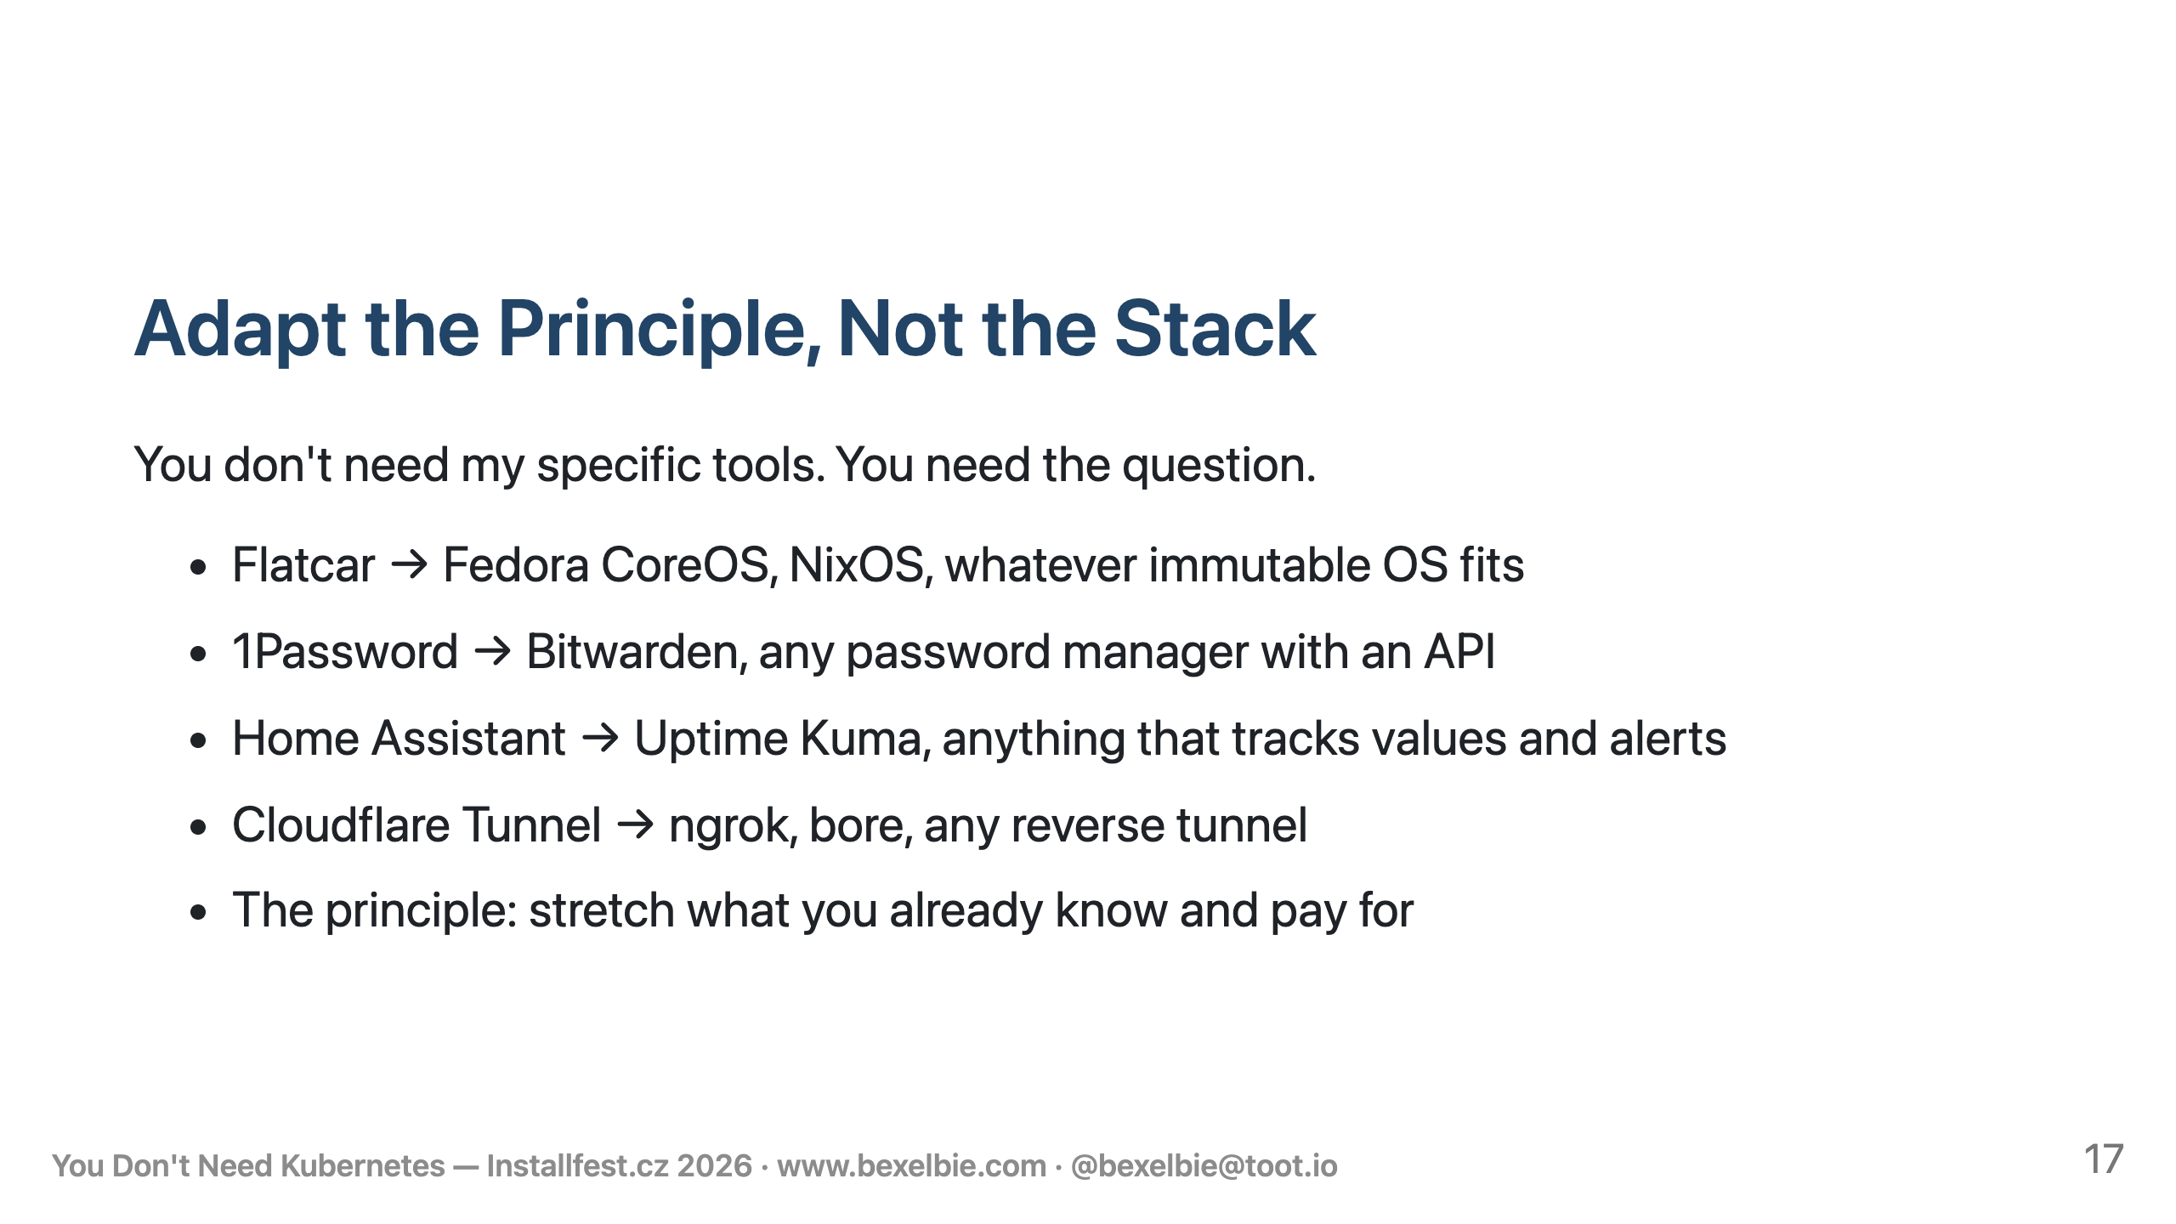
Notes:
- I want to be clear - this is not a talk about "use Flatcar, 1Password, Cloudflare, and Home Assistant." - Those are my answers. Yours will be different. - The transferable thing is the question - what do you already own that solves this? - The principle is the same - stretch the tools you already know, already pay for, already trust - Stop building infrastructure for your infrastructure. - Save your energy for the actual thing you wanted to build.

Slide 18

Notes:
- Thank you! - PuzzleSecretary is at puzzlesecretary.com if you want to see the thing itself - Slides are online at the QR Code and on my website - If you want the deep dive on Flatcar Linux, come to my Flatcar 101 talk at this conference - Questions?

Slide 19

Notes:
Mermaid rendering: use `marp --html` to enable Build Notes: Build: marp --pptx --html nokube-slides.md -o nokube-slides.pptx --allow-local-files QR Code: qrencode -o /Users/bexelbie/repos/blog/bexelbie.github.io/working-notes/qr-bexelbie.png -s 10 -m 2 "https://www.bexelbie.com"

